Slide 1
Discrete Mathematics: Lecture 28 Part IV. Graph Theory Graph Coloring, Tree, Characterization of Tree, Rooted Tree
Xuming He
Associate Professor
School of Information Science and Technology
ShanghaiTech University
Spring Semester, 2024
Notes by Prof. Liangfeng Zhang

Slide 2
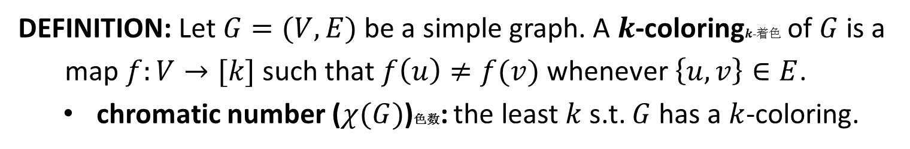

Review: Graph Coloring
DEFINITION: Let $G=(V,E)$ be a simple graph. A $k$-coloring$k$-着色 of $G$ is a
map $f:V→[k]$ such that $f\left(u\right)≠f(v)$ whenever $\left\{u,v\right\}∈E$.
chromatic number ($χ(G)$)色数: the least $k$ s.t. $G$ has a $k$-coloring.
$$χ\left(G\right)=3$$
The chromatic number is at least 3 because a; b; c is a circuit of length 3

Slide 3

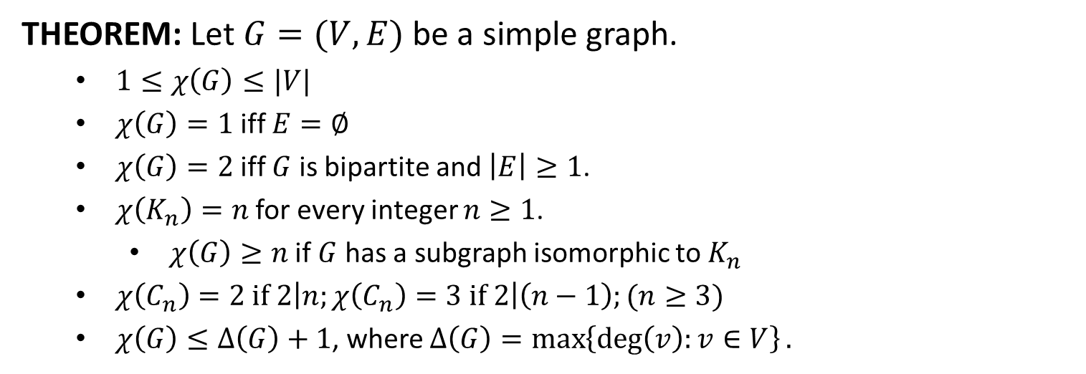






Graph Coloring
THEOREM: Let $G=(V,E)$ be a simple graph.
$1≤χ\left(G\right)≤|V|$
$χ\left(G\right)=1$ iff $E=∅$
$χ\left(G\right)=2$ iff $G$ is bipartite and $\left|E\right|≥1$.
$χ\left(K_{n}\right)=n$ for every integer $n≥1$.
$χ\left(G\right)≥n$ if $G$ has a subgraph isomorphic to $K_{n}$
$χ\left(C_{n}\right)=2 if 2\left|n;χ\left(C_{n}\right)=3 if 2\right|\left(n−1\right);(n≥3)$
$χ\left(G\right)≤Δ\left(G\right)+1$, where $Δ\left(G\right)=\max\left\{\deg\left(v\right):v∈V\right\}.$
$$1$$
$$1$$
$$2$$
$$2$$
$$1$$
$$3$$
$$2$$

Slide 4

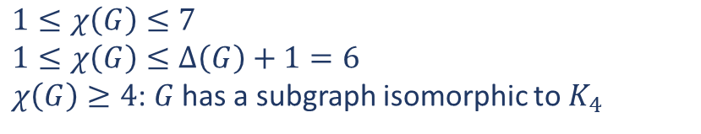
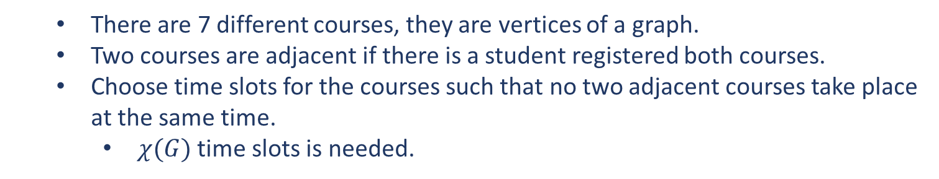
Application
PROBLEM: How can the final exams at a university be scheduled so that
no student has two exams at the same time?
$$χ\left(G\right)=4$$
There are 7 different courses, they are vertices of a graph.
Two courses are adjacent if there is a student registered both courses.
Choose time slots for the courses such that no two adjacent courses take place at the same time.
$χ(G)$ time slots is needed.
$$1≤χ\left(G\right)≤7$$
$$1≤χ\left(G\right)≤Δ\left(G\right)+1=6$$
$χ\left(G\right)≥4$: $G$ has a subgraph isomorphic to $K_{4}$

Slide 5
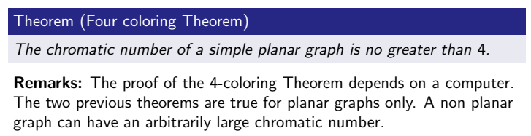
4-coloring Theorem

Slide 6
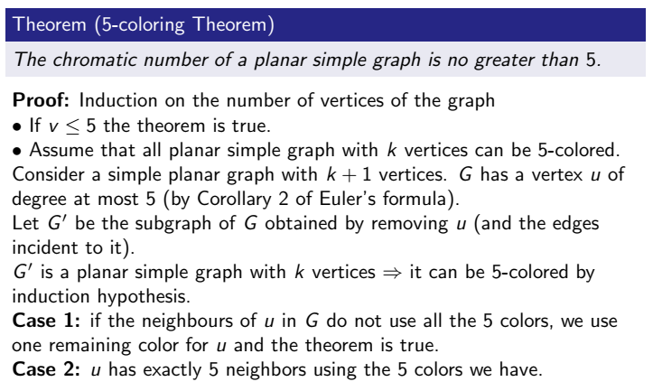
5-coloring Theorem*

Slide 7
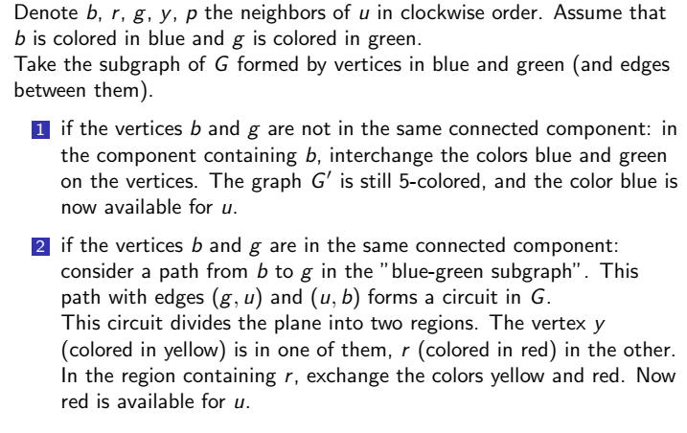
5-coloring Theorem*

Slide 8
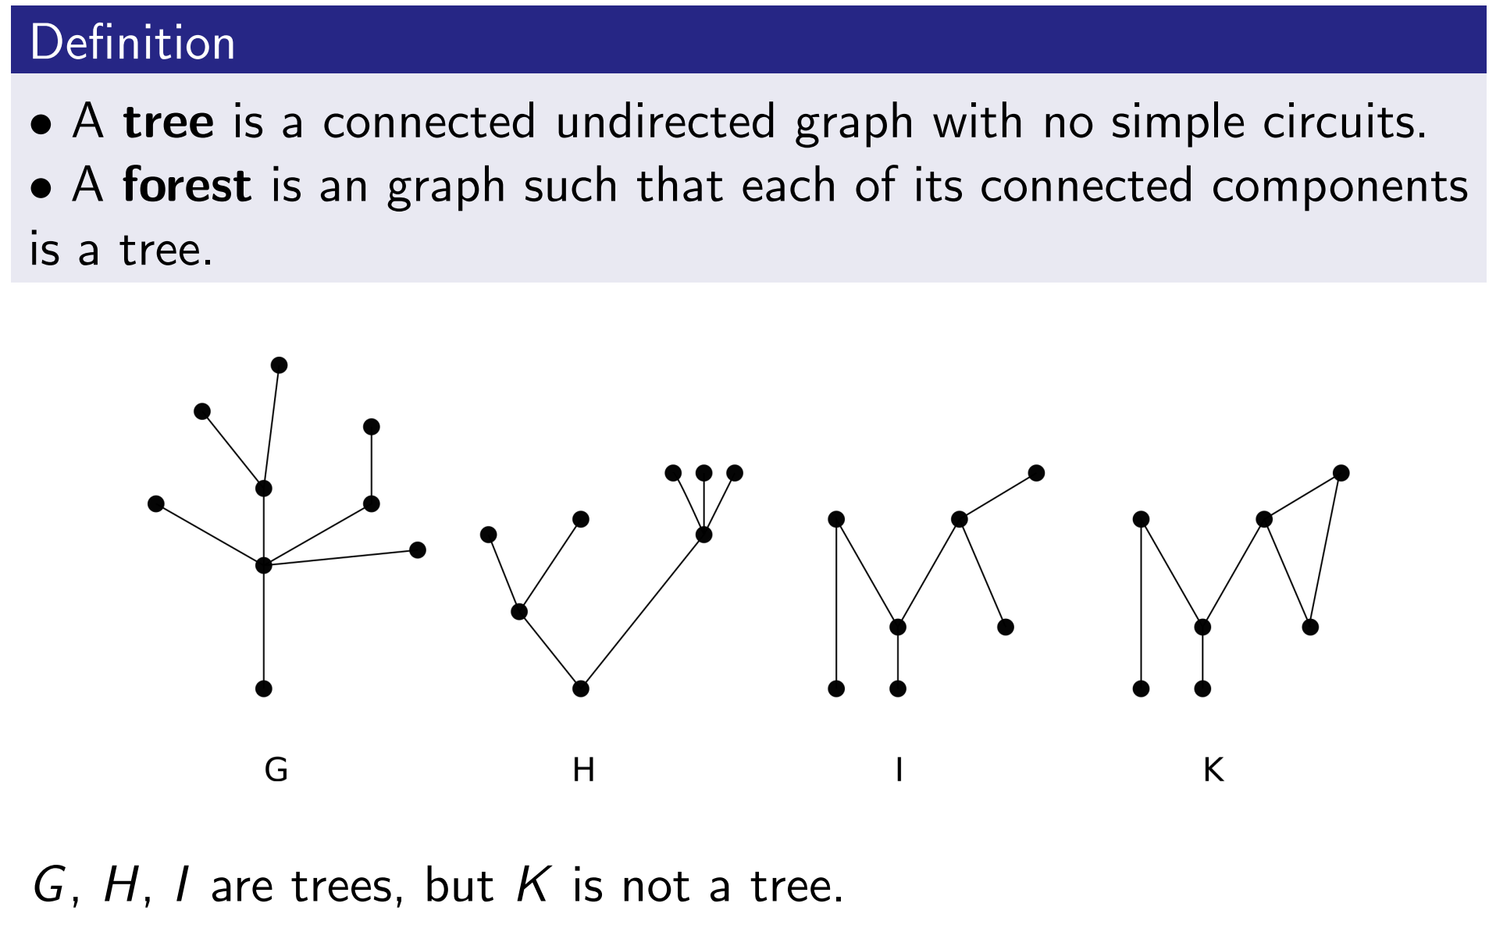
Tree

Slide 9
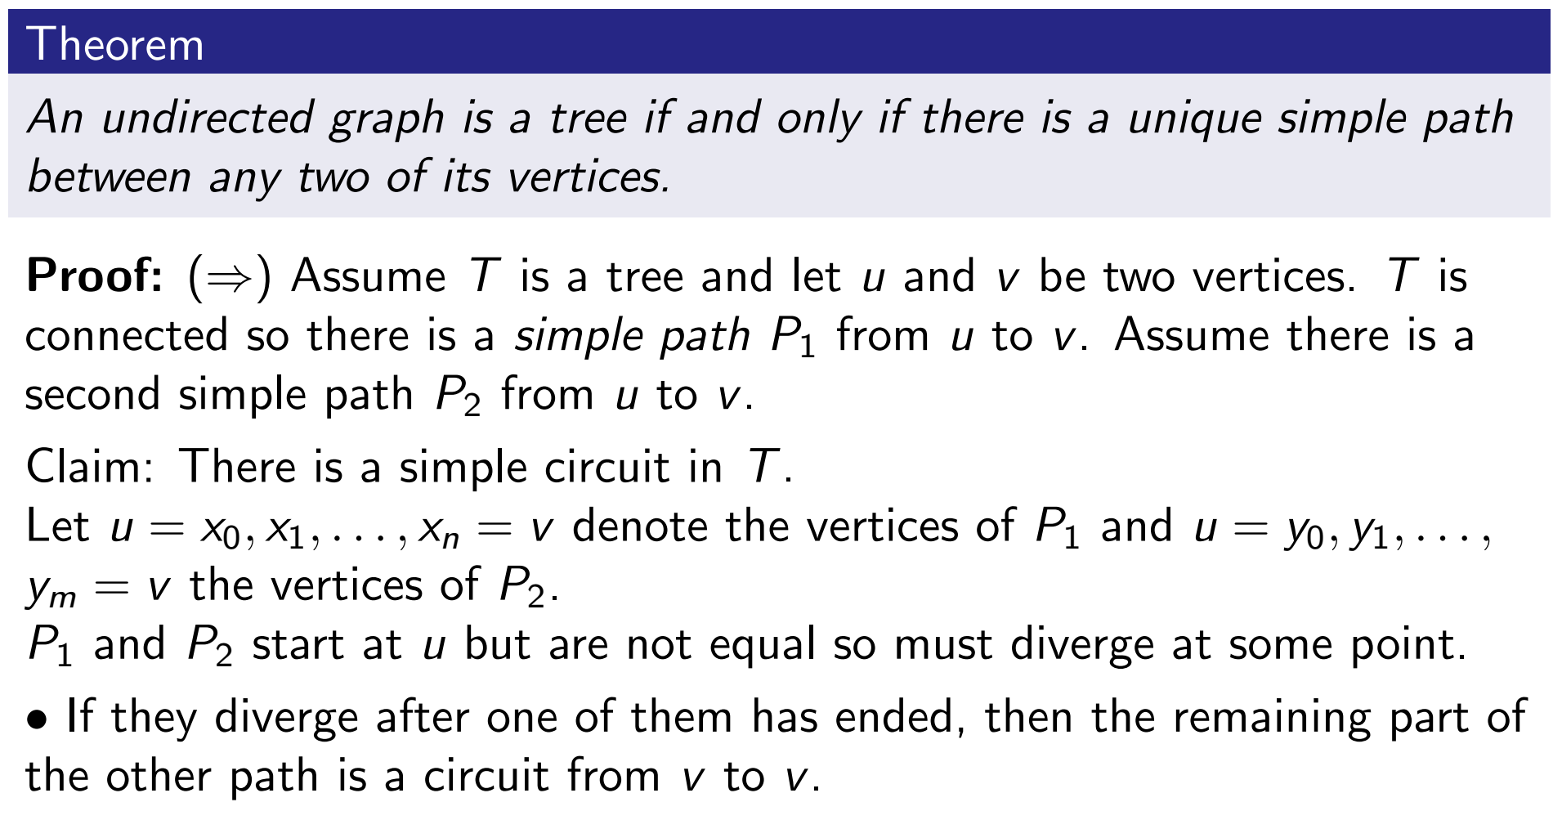
Characterization of Tree

Slide 10
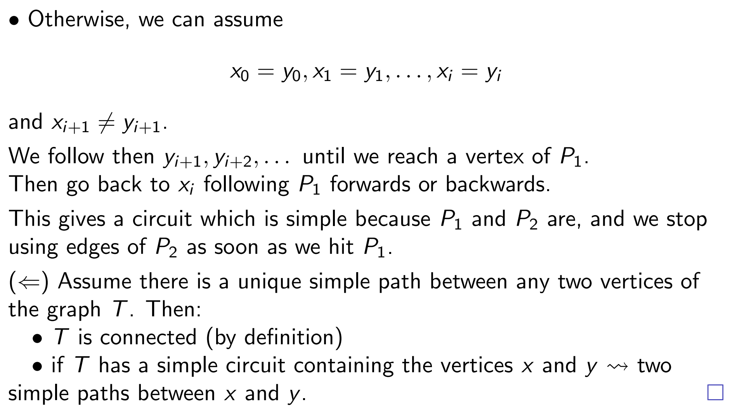
Characterization of Tree

Slide 11
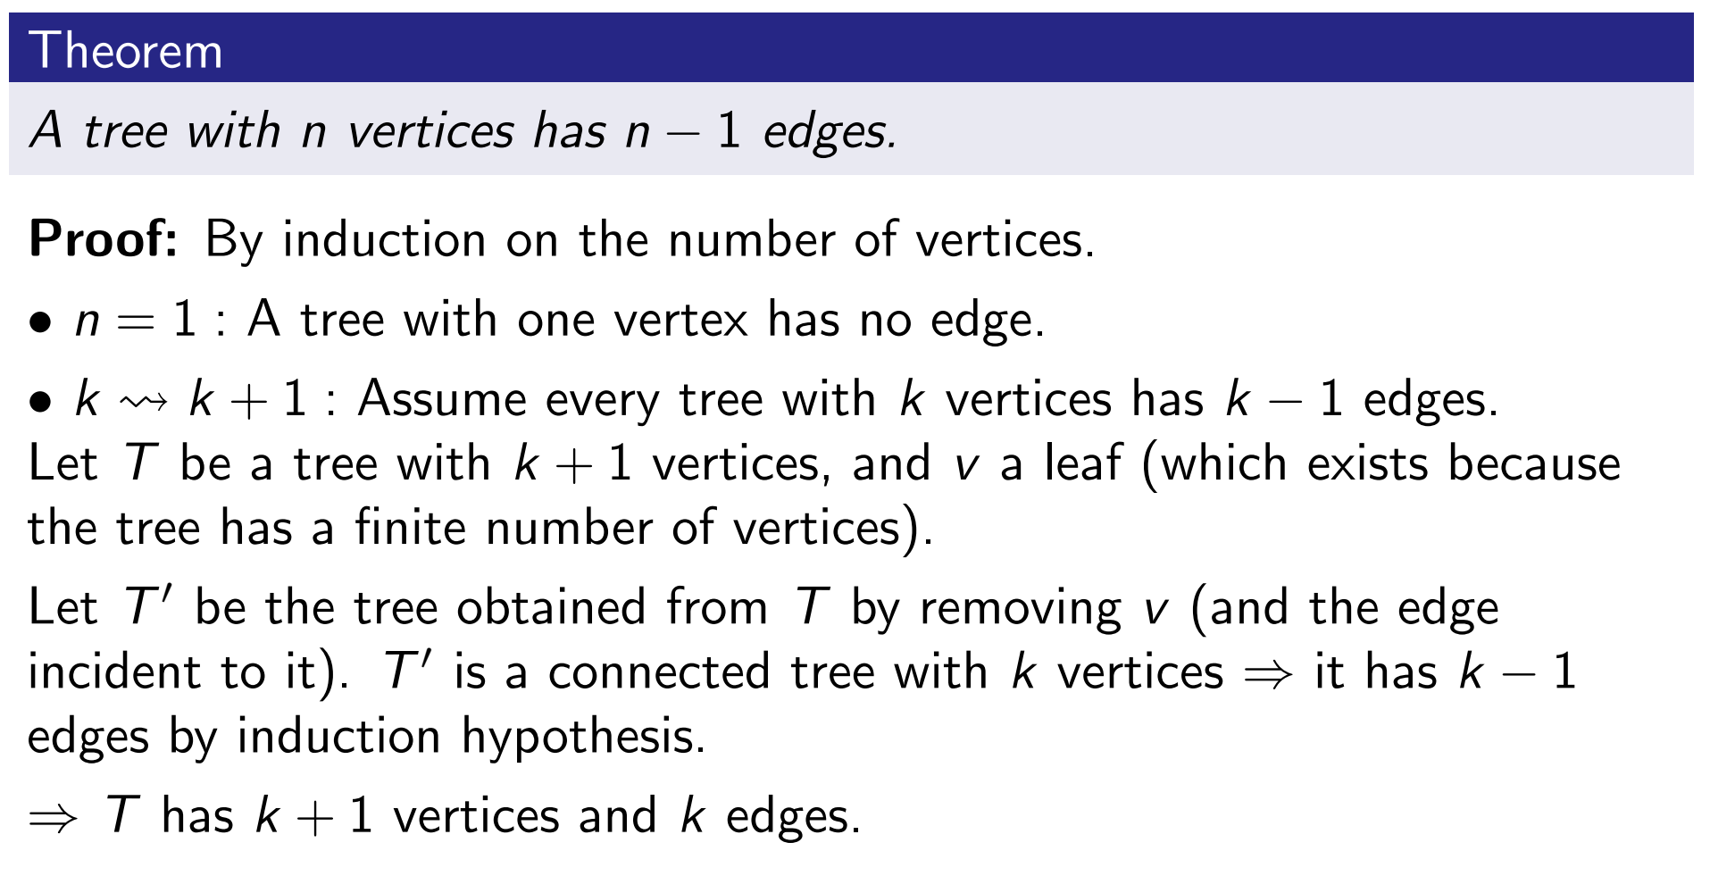
Properties of Tree

Slide 12
Properties of Tree

Slide 13
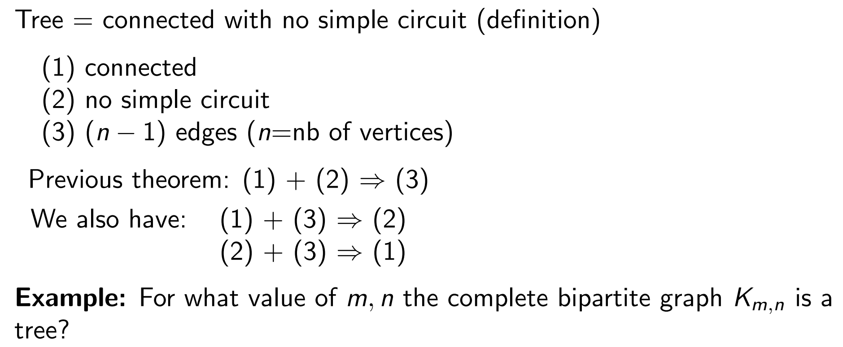
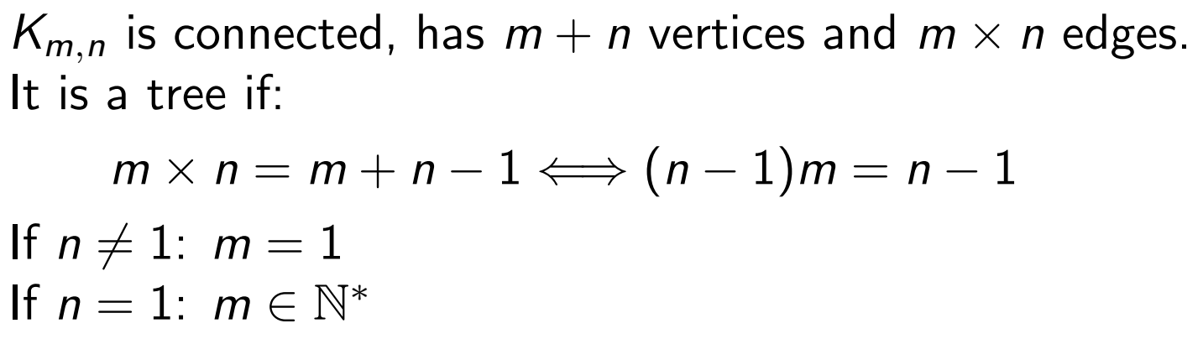
Properties of Tree

Slide 14
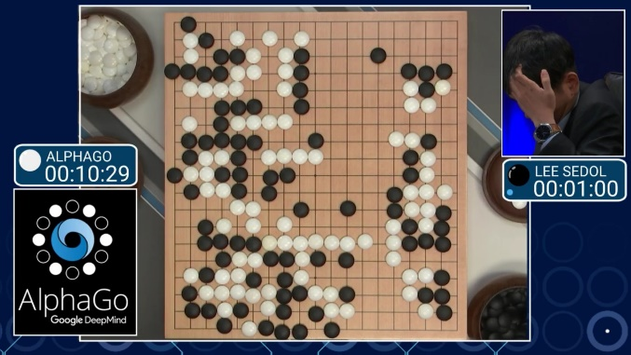
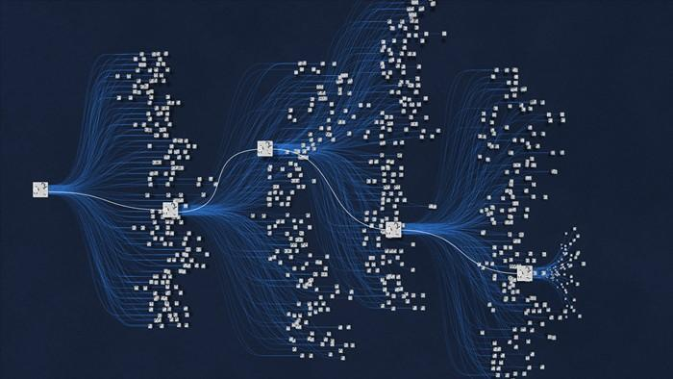
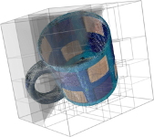
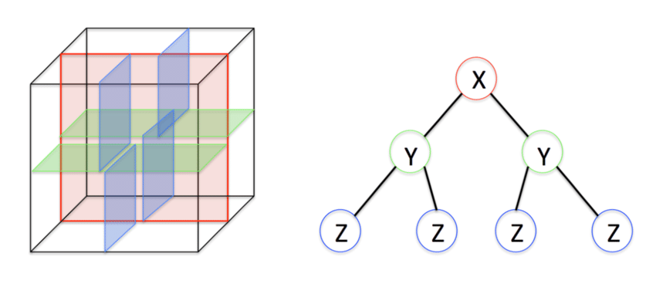
Applications
Trees are widely used in AI & other CS sub-areas
AlphaGo
Monte Carlo Tree Search
Point Cloud/3D Shape
KD Tree

Slide 15
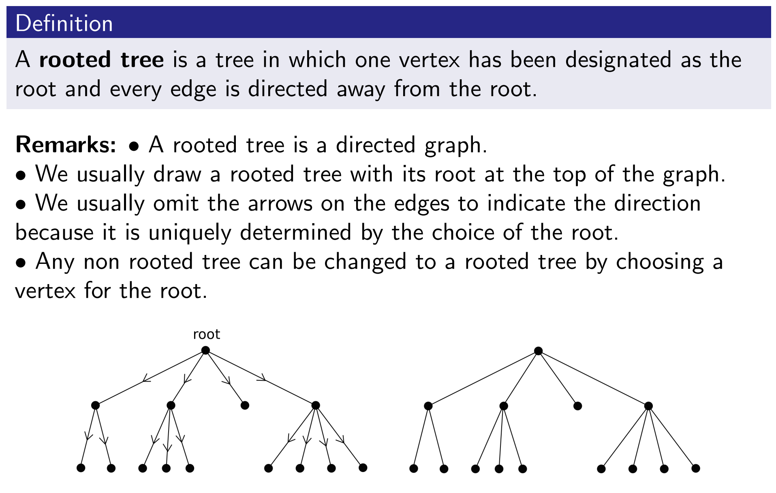
Rooted Tree

Slide 16
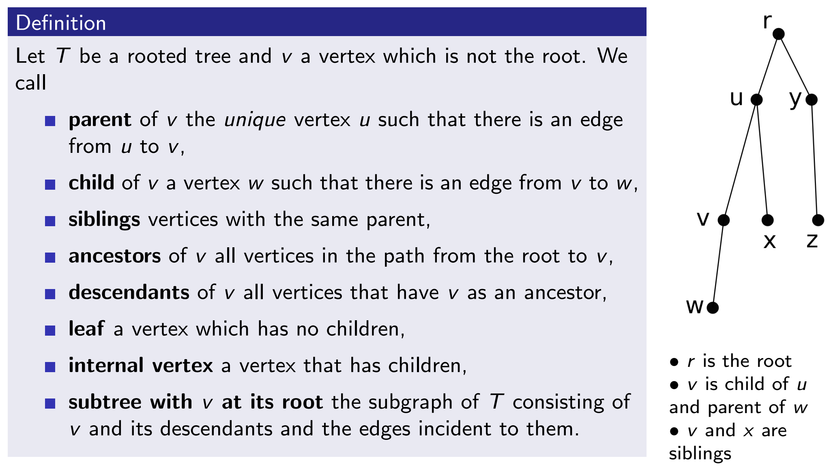
Rooted Tree

Slide 17
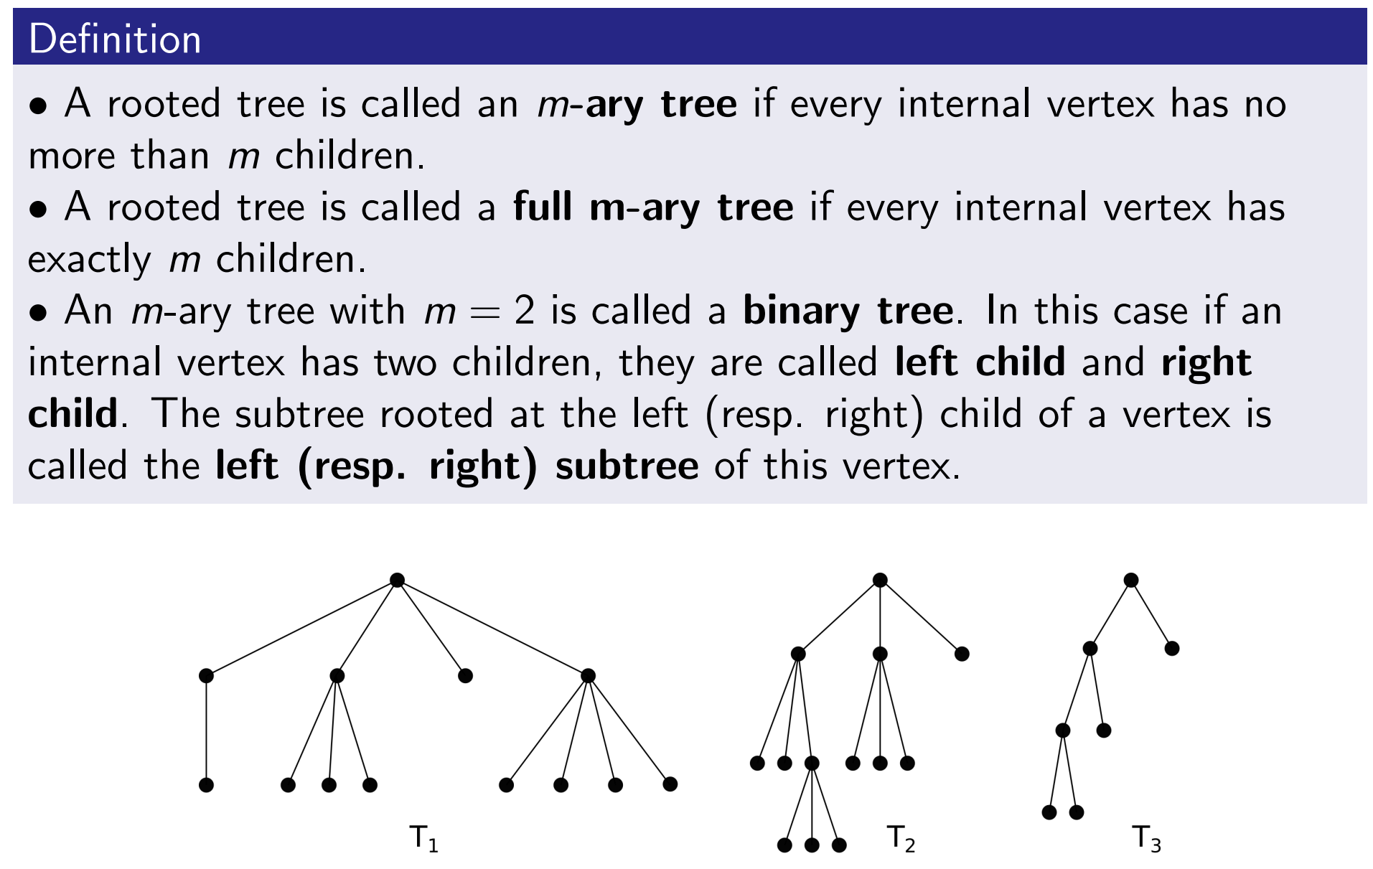
Rooted Tree

Slide 18
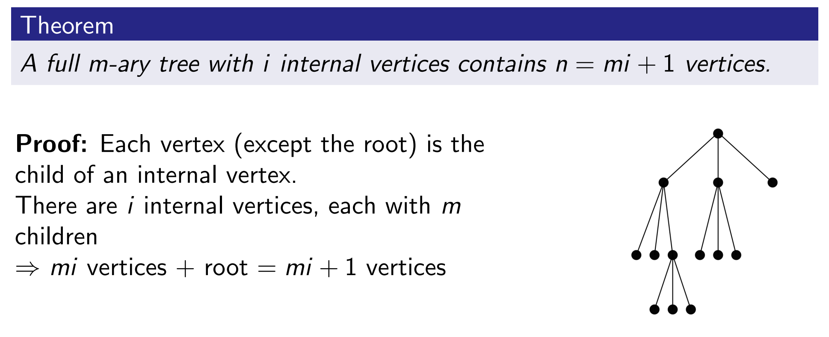
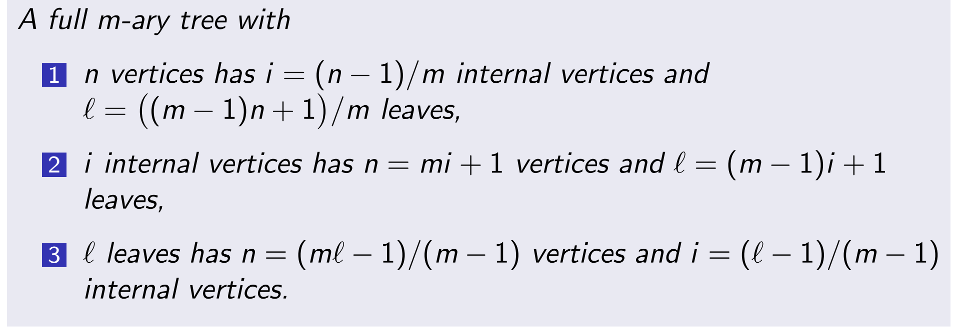
Properties of Tree

Slide 19
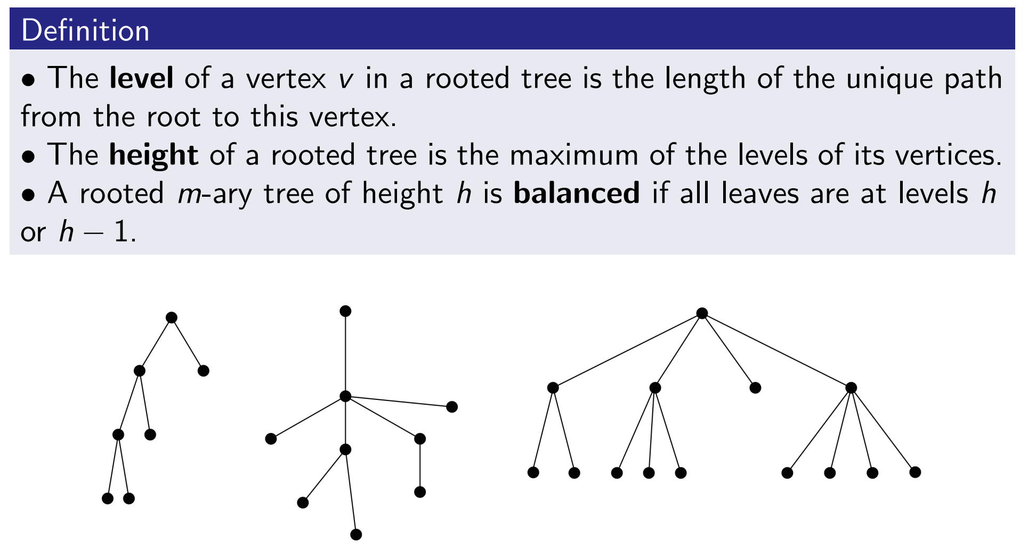
Balanced m-ary Tree

Slide 20
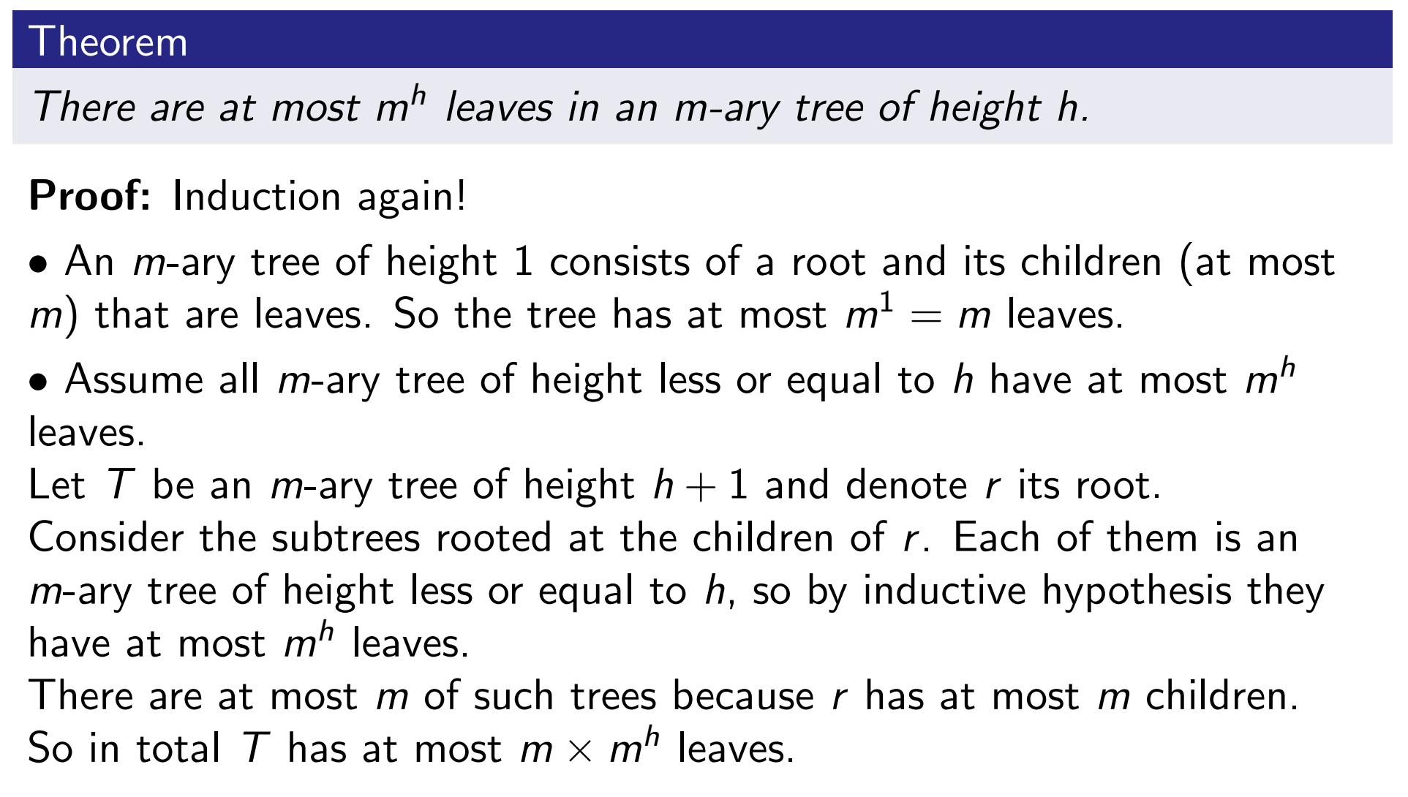
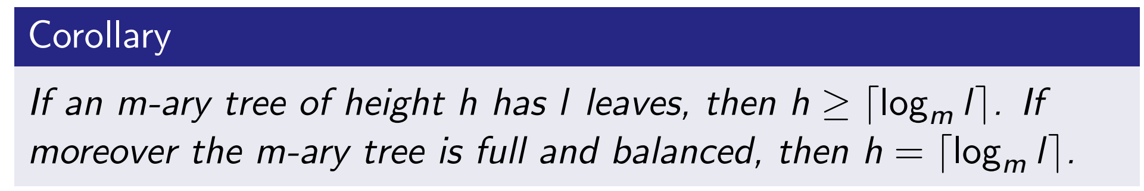
Balanced m-ary Tree

Slide 21
Balanced m-ary Tree*

